Slide 1
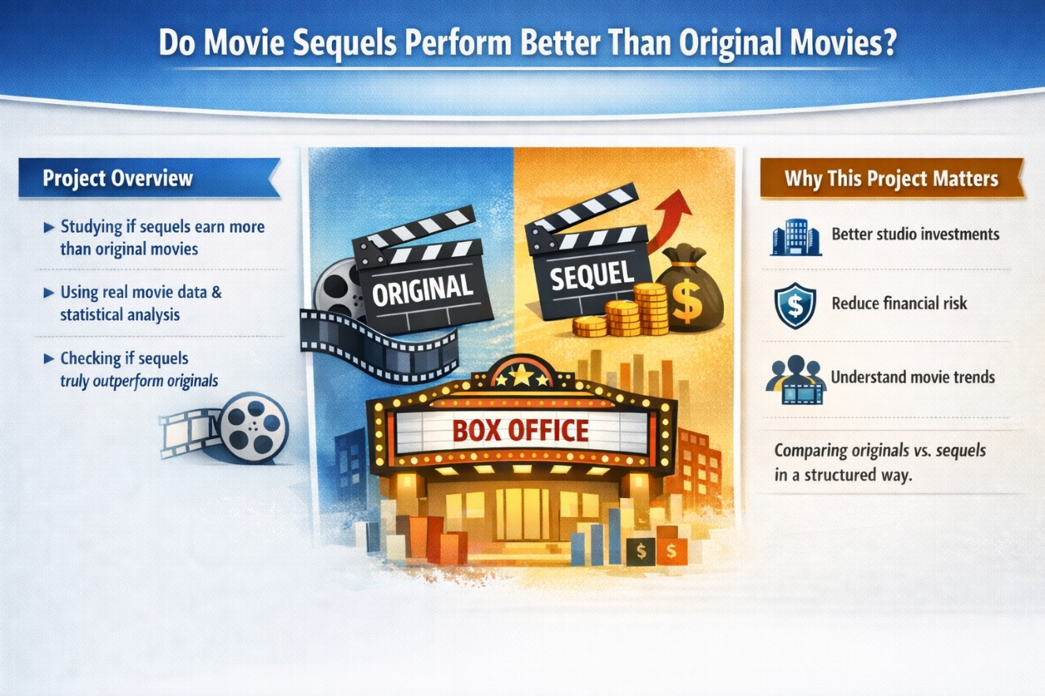
presentation title
916 YADAV PRAGATI GOPAL(Modeler/Predictor)
917 YADAV ANJALI PRAMOD(EDA Analyst)
918 RAUT YASH SURESH(Data Architect)
919 TELGE YASH UDAY(Insights Lead)
920 YADAV RAJNISH SHIVSHANKAR(Data Architect)

Slide 2


Slide 3

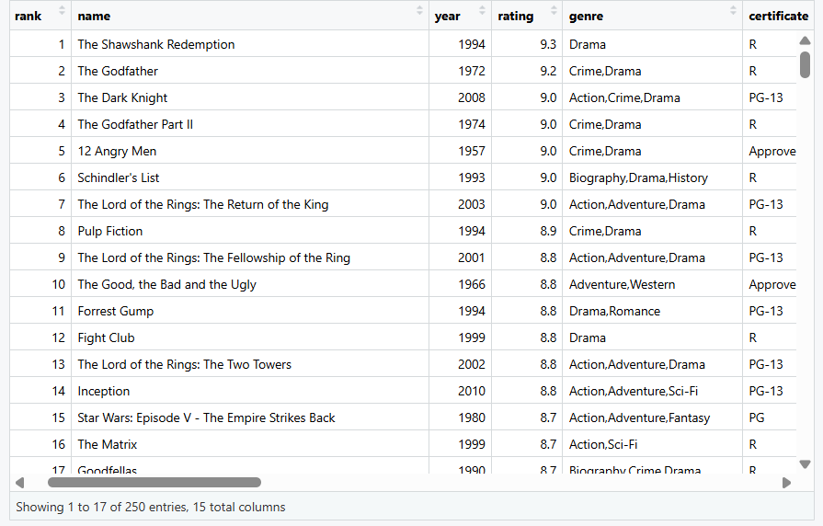
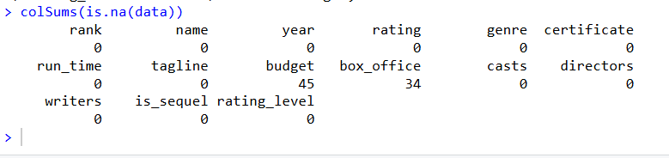
Data Architecture
The dataset was mostly complete, with missing values only in budget and box office columns. Since these fields are important for performance analysis, missing values were handled carefully to avoid incorrect results.

Slide 4
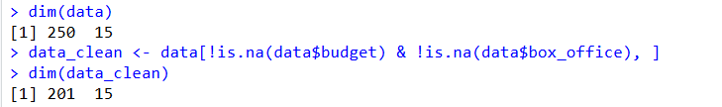
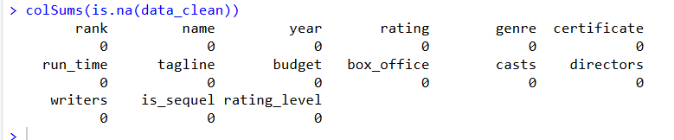

Since the dataset is small and financial columns are important for performance analysis, rows with missing budget or box office values were removed to avoid incorrect assumptions.
Only budget and box office had missing data
Filling values would reduce accuracy
Rows with missing financial data removed
Because the dataset was small, we chose accuracy over quantity and removed rows with missing financial data.

Slide 5
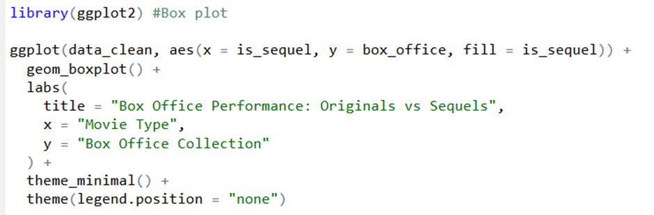
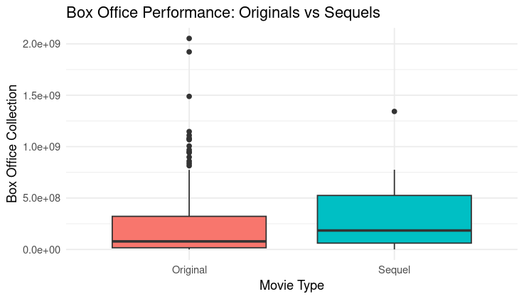
Exploratory Insights
The middle 50% (IQR) of sequels is clearly above that of originals.
While originals sometimes become blockbusters, most originals earn much less compared to sequels.
Sequels benefit from:
  Existing fan base
  Brand recognition
  Better marketing reach
Original movies show more extreme outliers.
Sequels show : Fewer extreme failures
Originals are high-risk, high-reward projects.
Sequels reduce financial uncertainty for studios.

Slide 6
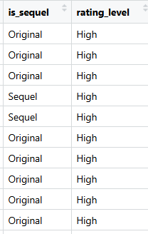
Feature Strategy
Feature 1: is_sequel (Original vs Sequel)
Created a new column to label movies as: Original and Sequel
Movie titles containing numbers like 2, 3, Part II, etc. were marked as Sequels
All others were marked as Originals
Feature 2: Budget Category (Low / High)
Why this helps
Makes patterns easier to understand
Helps compare success across budget levels
Useful for business decisions
Budget and box office revenue were used as separate numerical features to capture spending and earning patterns.

Slide 7
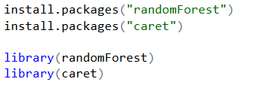
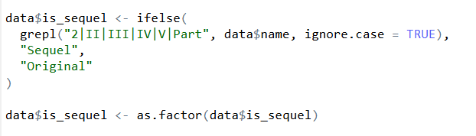

Modeling Approach
Step 1: Load Libraries
In our project, the goal is:
To understand whether sequels perform better than original movies and what factors influence performance.
Handles Complex Relationships
Works Well With Mixed Data
  Less Sensitive to Outliers
Better Performance Than GLM
Helps Understand Feature Importance
Step 2: Create Sequel Variable

Slide 8
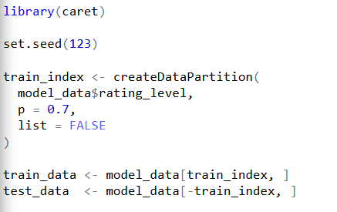
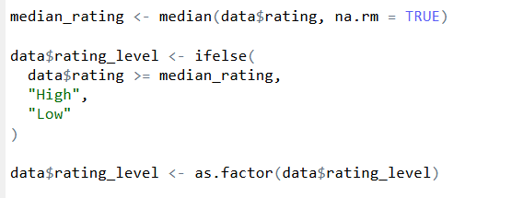
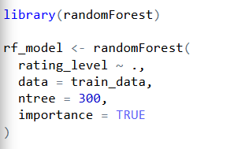
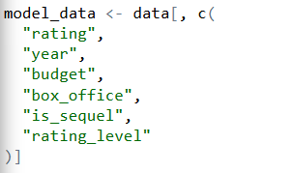
Step 3: Create Target Variable (High vs Low Rating)
STEP 5: Train–Test Split
STEP 6: Train Random Forest Model
Step 4: Select Only Required Columns

Slide 9

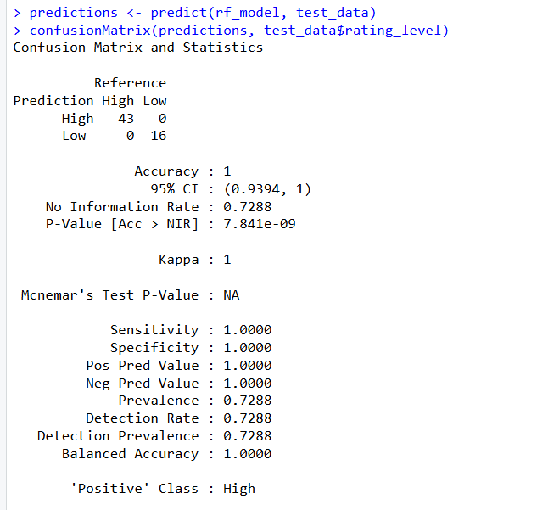
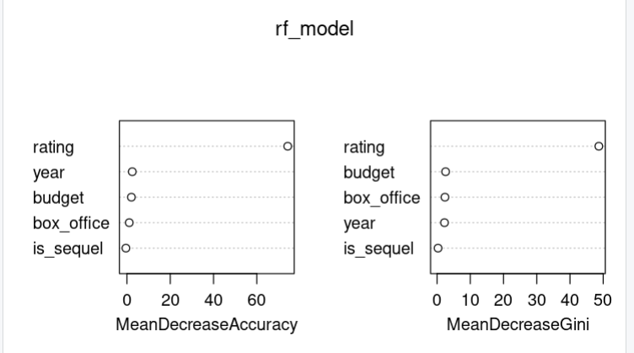
Model Evaluation
STEP 7: Evaluate the Model

Slide 10
The "So What?"
Recommendation 1: Focus on Quality to Achieve High Ratings
The model shows that movie rating is the strongest factor in predicting success.
Movies with higher ratings consistently fall into the High category.
Recommendation 2: Budget and Box Office Matter, but Smart Spending Wins
Budget and box office are important predictors, but not as strong as ratings.
High budget alone does not guarantee a high-rated movie.
Recommendation 3: Sequels Are Not Automatically Better
The variable is_sequel had lower importance compared to ratings and budget.
Being a sequel does not guarantee higher ratings.
Movie success is driven more by quality and audience reception than by high budgets or sequel branding.

Slide 11
Technical Reflection
R Libraries Used
tidyverse – Data cleaning, filtering, and manipulation
ggplot2 – Creating boxplots, bar charts, and visual insights
caret – Data splitting, model evaluation, and confusion matrix
randomForest – Building the prediction model
stringr – Text handling (detecting sequels from movie titles)
Biggest Coding Challenges Faced
Handling Missing Values
Budget and box office columns had many missing values, which caused model errors.
Feature Engineering
Creating new variables like Sequel vs Original and High vs Low Rating required careful string parsing and logic.
Model Evaluation Confusion
Understanding why the confusion matrix showed very high accuracy and ensuring the model was not breaking due to data leakage.

Slide 12
Q&A – Open floor for questions.
Thank you for listening
We are happy to answer your questions about the data, analysis, and results.
Dataset: IMDb Top 250 Movies
Tools: R, Random Forest, ggplot2

Slide 13
thank you
GITHUB Link: https://github.com/ritgithubsiya/DataScience_Project_Box-Office-The-Sequel-Trap.

